Slide 1

UM Course Sharing
CS 4380: Group 8
Team Member:
Jeffrey Friel
Bobby Fink
Clark Blumer
Hayder Al-Behadili

Slide 2
Client
University of Missouri System Office of Academic Affairs
Project Sponsor: Jana Moore, Office of Academic Affairs
Technical Sponsor: Leigh Durdle, Director of Student Information Systems
Subject Matter Expert: Carla Whitney, Office of University Registrar (Columbia)

Slide 3
Project Overview
University of Missouri Shared Course initiative is a program that allows students from one of the 4 UM System campuses to enroll in a course that is taught on another UM System campus.

Slide 4
Expectations
Current Issues
Manual tracking of shared course proposals
Excel spreadsheet used to track primary and secondary course pairings
Manual population of data in the XFER table used by
Data entry errors
Manual tracking of proposal requested budgets
Application Expectations
Electronic tracking of proposal status
Link proposed primary and secondary courses to avoid confusion
Link approved primary and secondary shared courses from PeopleSoft Campus Solutions
Track proposal, primary and secondary course requested budgets
Automatically populate the XFER table with approved and linked shared courses

Slide 5
Software/Database
Software Stack
PHP/CodeIgniter
Apache Web Server
Oracle 11g
Code Repository
github
Due to FERPA and sensitive data, the project group was not provided access to the clients web server and Oracle database. Security was not a requirement for this phase of the project and will be handled in phase 2 which will integrate the application with shibboleth access control by the client’s IT team.
Each team member ran a matching virtual WAMP server with an identical software stack and github was used for code repository and version control.

Slide 6
Database Design
The design of the database went through five iterations, including 1 complete re-design to better handle the proposed primary/secondary and shared primary/secondary relationships after input from the technical sponsor Leigh Durdle.

Slide 7
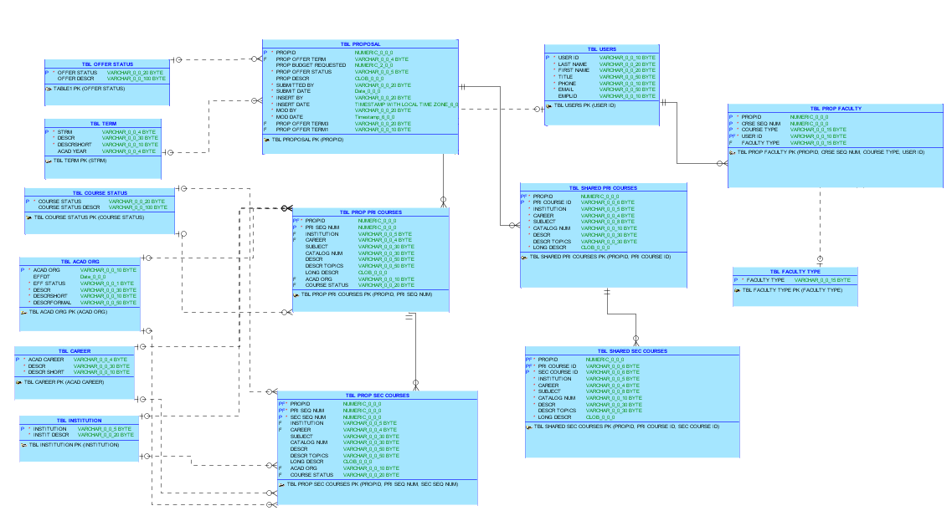
Course Share ERD

Slide 8
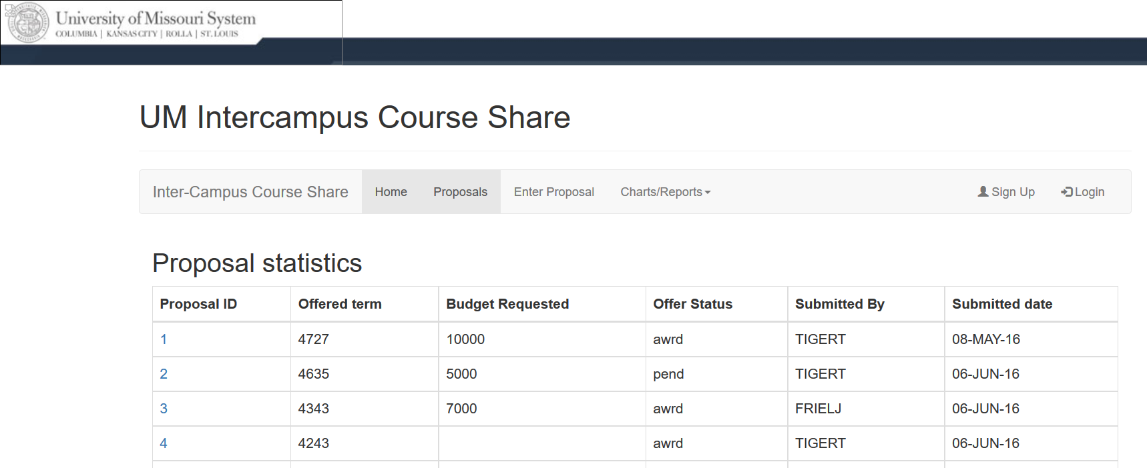
Application Demo

